Slide 1
Methods
Object Oriented Programming
Lecture # 7
Prepared by: Mehak Usmani

Slide 2
Content
This Keyword
finalize Method
Method Overloading

Slide 3
Events Drive Object Collaboration
At its simplest, the process of object-oriented software development involves the following four basic steps:
1. Properly establishing the functional requirements for, and overall mission of, an application
2. Designing the appropriate classes—their data structures, behaviors, and relationships with one another—necessary to fulfill these requirements and mission
3. Instantiating these classes to create the appropriate types and number of object instances
4. Setting these objects in motion through external triggering events

Slide 4
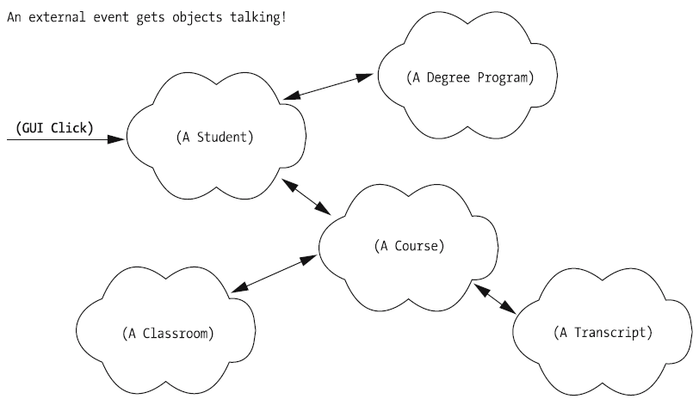
Events activating objects

Slide 5
Declaring Methods
In order for an object A to request some service of an object B, A needs to know the specific language with which to communicate with B. That is,
Object A needs to be clear as to exactly which of B’s methods/services A wants B to perform.
Depending on the service request, object A may need to give B some additional information so that B knows exactly how to proceed.
Object B in turn needs to know whether object A expects B to report back the outcome of what it has been asked to do.

Slide 6
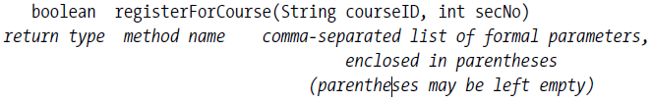
Method Headers
A method header is a formal specification (from a programming standpoint) of how that method is to be invoked. A method header, at minimum, consists of
• A method’s return type—that is, the type of information that is going to be returned by object B to object A, if any, when B’s method finishes executing.
• A method’s name.
• An optional list of comma-separated formal parameters (specifying their types and names) to be passed to the method, enclosed in parentheses.

Slide 7
Method Naming Conventions
Java method names are crafted using the camel casing style;
• The first letter of the method name is in lowercase.
• The first letter of each subsequent concatenated word in the method name is in uppercase, and the remaining characters are in lowercase.
• We don’t use any “punctuation” characters—dashes, underscores, etc.—to separate these words.

Slide 8
Passing Arguments to Methods
The purpose of passing arguments into a method is two fold:
• To provide it with the (optional) “fuel” necessary to do its job
• To otherwise guide Its behavior in some fashion
boolean registerForCourse(String courseID, int secNo)
int getAge(int ageType)
Parameter, e.g String getMyFood(String timing)
Argument, e.g. int a = Math.pow(2,4)

Slide 9
Method Return Types
The registerForCourse method as previously declared is shown to have a return type of boolean, which implies that this method will return one of the following two values:
• A value of true, to signal “mission accomplished”—namely, that the Student object has successfully registered for the course that it was instructed to register for.
• A value of false, to signal that the registration request has been denied for some reason. Perhaps the desired section was full, or the student didn’t meet the prerequisites of the course, or the requested course/section has been canceled, etc.

Slide 10
An Analogy
let’s say that a person is capable of
• Taking out the trash
• Mowing the lawn
• Washing the car
Expressing this notion in Java code, we’d perhaps declare three methods for the Person class, one for each chore (service):
• void takeOutTheTrash()
• boolean mowTheLawn()
• void washTheCar(Car c)

Slide 11
Methods properties
Can be declared in any order
A return statement is a jump statement that is used to exit a method.
Method implements business rule.

Slide 12
Capturing the Value Returned by a Method
boolean registerForCourse(String courseId, int sectionNumber)
x.registerForCourse("MATH 101", 10);
boolean successfullyRegistered = x.registerForCourse("MATH 101", 10);

Slide 13

Methods
A method definition consists of its method name, parameters, return value type, and body.
Methods can be used to define reusable code and organize and simplify code. A method is a collection of statements grouped together to perform an operation..
Syntax
If a method returns a value, it is called a value returning method, otherwise it is called a void method.
Some programming languages refer to methods as procedures and functions.

Slide 14
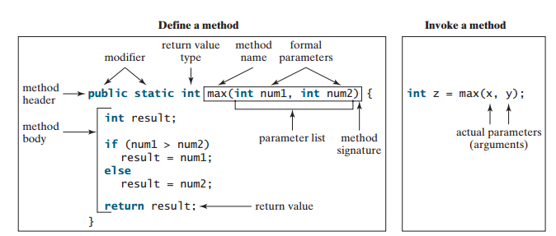

Slide 15
Calling a method
Calling a method executes the code in the method.
To execute the method, It has to be called or invoke.
There are two ways to call a method, depending on whether the method returns a value or not.
If method returns a value;.
If a method returns void, a call to the method must be a statement.
When a program calls a method, program control is transferred to the called method. A called method returns control to the caller when its return statement is executed or when its method ending closing brace is reached.

Slide 16
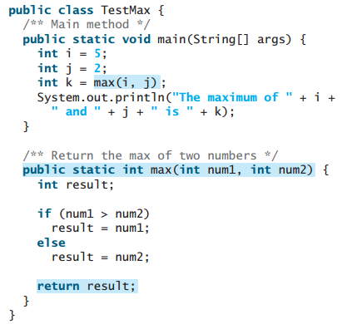

Slide 17
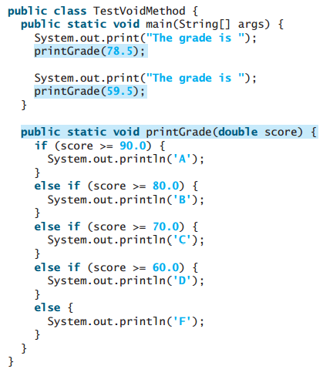

Slide 18
Parameters
The power of a method is its ability to work with parameters.
When calling a method, you need to provide arguments, which must be given in the same order as their respective parameters in the method signature. This is known as parameter order association.
When a method is invoked with an argument, the value of the argument is passed to the parameter. This is referred to as pass-by-value.
If the argument is a variable rather than a literal value, the value of the variable is passed to the parameter.
The variable is not affected, regardless of the changes made to the parameter inside the method.

Slide 19
Method Signatures
void switchMajor(String newDepartment, Professor newAdvisor)
We refer to a method’s signature as those aspects of a method header that are “discoverable” by inspecting the code used to invoke the method, namely,
• The method’s name
• The order, types, and number of parameters declared by the method
but excluding
• The parameter names
• The method’s return type

Slide 20
Examples
• Method header: int getAge(int ageType)
• Method signature: getAge(int)
• Argument signature: (int)
• Method header:
void chooseMajor(String newDepartment, Professor newAdvisor)
• Method signature: chooseMajor(String, Professor)
• Argument signature: (String, Professor)

Slide 21
Method Overloading
Overloading is a language mechanism that allows two or more different methods belonging to the same class to have the same name as long as they have different argument signatures
void print(String fileName) { ... // version #1
void print(int detailLevel) { ... // version #2
void print(int detailLevel, String fileName) { ... // version #3
int print(String reportTitle, int maxPages) { ... // version #4
boolean print() { ... // version #5
Print method is overloaded

Slide 22
Method Overloading
Two or more methods can be defined within the same class that share the same name with different parameter declarations . The methods are said to be overloaded, and the process is referred to as method overloading.
Method overloading is one of the ways that Java supports polymorphism.
When an overloaded method is invoked, Java uses the type and/or number of arguments as its guide to determine which version of the overloaded method to actually call.
Overloaded methods must differ in the type and/or number of their parameters.
Overloaded methods may have different return types, the return type alone is insufficient to distinguish two versions of a method.
Method overloading increases the readability of the program

Slide 23
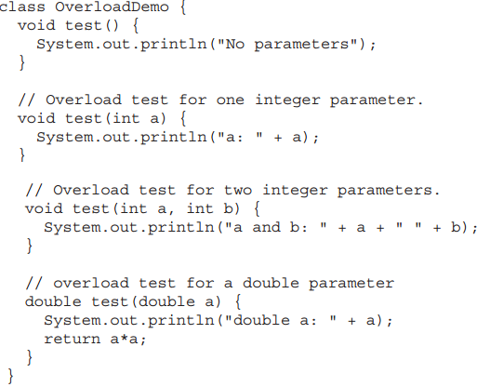
Method Overloading
Class implementing Method Overloading

Slide 24
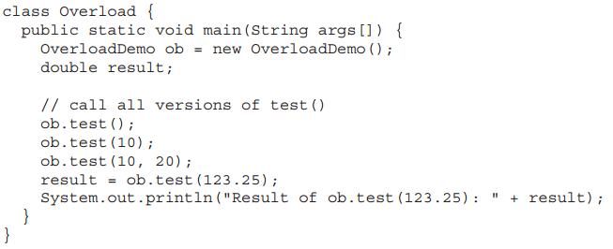
Method Overloading
Calling overloaded Methods

Slide 25
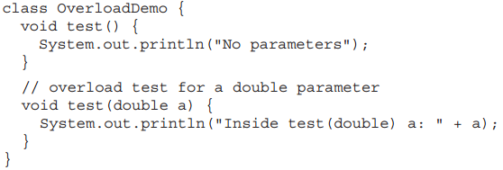
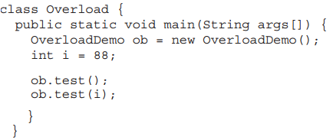
Type conversion in Method Overloading
The method matching need not always be exact. In some cases, Java’s automatic type conversions can play a role in overload resolution.
Java will employ its automatic type conversions only if no exact match is found.
In addition to this, constructors can also be overloaded.

Slide 26
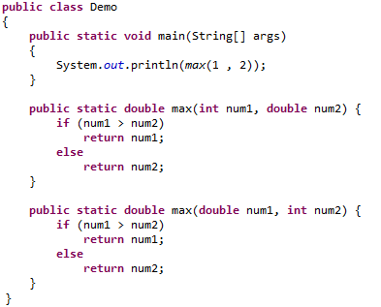
Which method will be called?

Slide 27
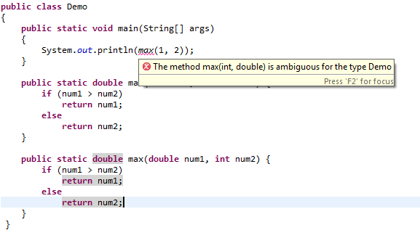
Error!

Slide 28
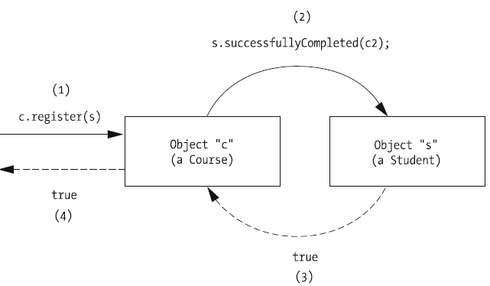
Message Passing Between Objects
Assume that we have two classes defined—Student and Course—and that the following methods are defined for each.
For the Student class:
boolean successfullyCompleted(Course c)
For the Course class:
boolean register(Student s)

Slide 29
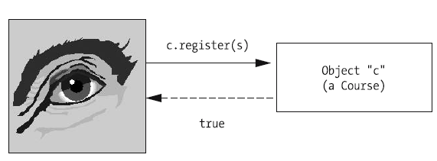
Delegation
If a request is made of an object A and, in fulfilling the request, A in turn requests assistance from another object B, this is known as delegation by A to B.
The fact that delegation has occurred between objects is often transparent to the initiator of a message, as well.

Slide 30
Obtaining Handles on Objects
The only way that an object A can pass a message to an object B is if A has access to a reference to/handle on B. This can happen in several different ways.
Object A might maintain a reference to B as one of A’s attributes.
public class Student {
// Attributes.
String name;
Professor facultyAdvisor;

Slide 31
Obtaining Handles on Objects (1)
2. Object A may be handed a reference to B as an argument of one of A’s methods.
c.register(s);
A reference to object B may be made “globally available” to the entire application
Object A may have to explicitly request a handle/reference to B by calling a method on some third object C.

Slide 32
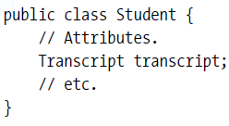
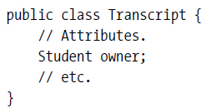
Obtaining Handles on Objects (2)
Going back to our previous example, let us introduce Transcript as well
First, we’ll introduce a third object: a Transcript object t, which represents a record of all courses taken by Student object s.
Furthermore, we’ll assume that Student s maintains a handle on Transcript t as one of s’s attributes (specifically, the transcript attribute) and, conversely, that Transcript t maintains a handle on its “owner,” Student s, as one of t’s attributes:

Slide 33
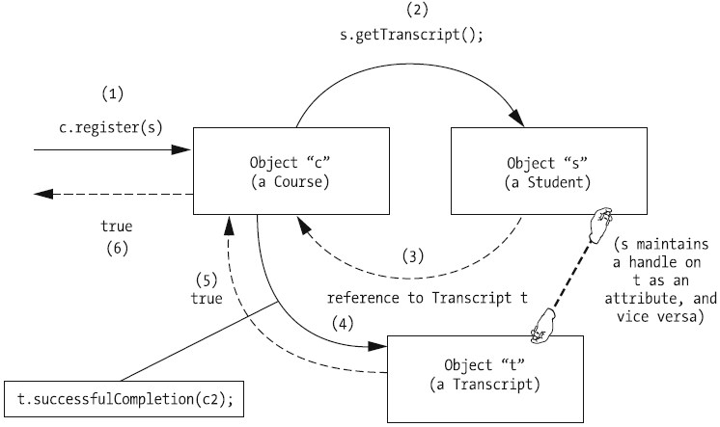
Obtaining Handles on Objects (3)

Slide 34
Objects As Clients and Suppliers
a Course object and a Student object, we can consider Course object c to be a client of Student object s, because c is requesting that s perform one of its methods—namely, getTranscript—as a service to c.

Slide 35
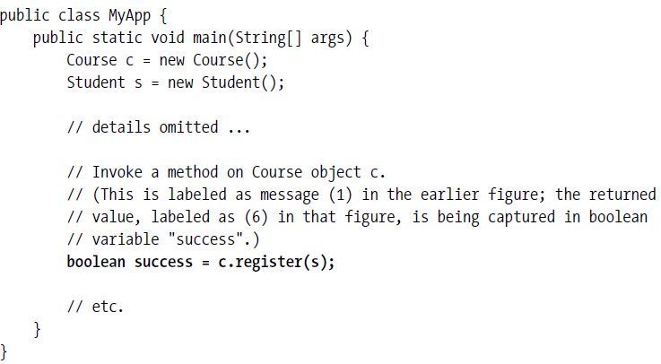
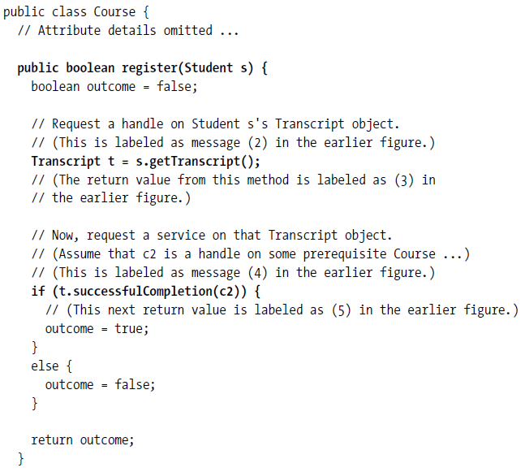
Objects As Clients and Suppliers (1)

Slide 36
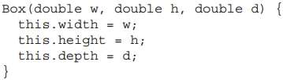
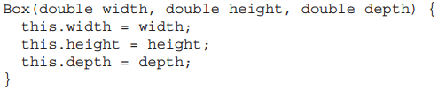
The this Keyword
this can be used inside any method to refer to the current object. That is, this is always a reference to the object on which the method was invoked.
It can be used anywhere a reference to an object of the current class’ type is permitted.
When a local variable has the same name as an instance variable, the local variable hides the instance variable. this lets program refer directly to the object, It can be used to resolve any name space collisions.
Use of this
Use of this to avoid name collision

Slide 37
this Usage
this keyword can be used to refer current class instance variable.
this() can be used to invoke current class constructor. Call to this() must be the first statement in constructor.
this keyword can be used to invoke current class method (implicitly) If this is not used, compiler automatically adds this keyword while invoking the method.
this can be passed as an argument in the method call for method in same class.
this can be passed as argument in the constructor call.
this keyword can also be used to return the current class instance.
return_type method_name(){
return this;
}

Slide 38
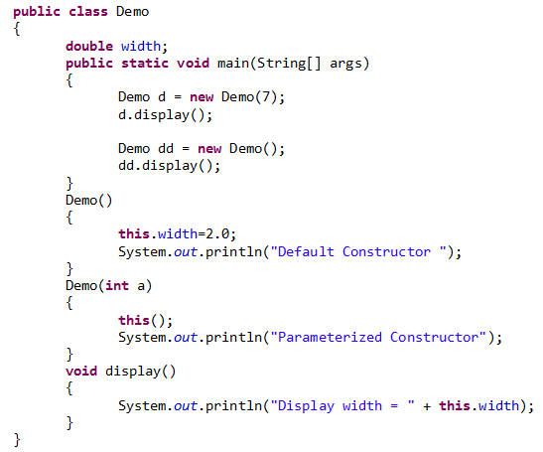
Notes:
Output:
Default
parameter
Display width = 2.0
Default
Display width = 2.0

Slide 39

The finalize( ) Method
By using finalization, specific actions can be define that will occur when an object is just about to be reclaimed by the garbage collector.
finalize() perform some action when object is destroyed.
To add a finalizer to a class, simply define the finalize( ) method. Right before an asset is freed, the Java run time calls the finalize( ) method on the object.
Example, if an object is holding some non-Java resource such as a file handle, then these resources should be freed before an object is destroyed.
During execution it is not known when or even if finalize( ) will be executed or not.
The finalize( ) method only approximates the function of a destructor.
Notes:
C++ allows you to define a destructor for a class, which is called when an object goes out-of-scope. Java does not support this idea or provide for destructors.
Called by the garbage collector on an object when garbage collection determines that there are no more references to the object

